Slide 1
University Students' Performance & Study Habits Report 2026
Sarah Redmon & Wes Smith (Group 5)
CSC 783 – Data Visualization
Spring 2026

Slide 2
Dataset Description
Title: “University Students Performance & Study Habits 2026”
The dataset contains 10,000 students (i.e., 10,000 rows). There are no missing values and there is also one CSV file.
There are 27 columns, including but not limited to GPA, AI usage, and sleep time.
The dataset is a static dataset, a snapshot from 2026, with a new dataset released each year.

Slide 3
Dataset Description cont.
The dataset includes a list of students from many countries and backgrounds.
The overall purpose of the dataset is to show the correlations and relationships between the study habits and academic performance.
The dataset can help students know what specifically they can improve on, as well as help educators and researchers know what contributes to student performance, so they can bring forth information that emphasizes what can help make students’ habits healthier and bring the best possible outcomes (i.e., high GPA).

Slide 4
Research Questions
Does increased study time always lead to better performance?
Can sleep and study time be optimally balanced?
Is stress the most important factor in the dataset?

Slide 5
Research Question 1 - Does increased study time always lead to better performance?
Optimal study time is around 3-5 hours being much more effective if combined with sleep time 7-8 hours and low levels of stress. Study time effectiveness starts to taper off around 6 hours and leads to higher levels of stress.

Slide 6
Research Question 2 - Can sleep and study time be optimally balanced?
The best balance of sleep to study time is 3-5 hours per day of study time to 7-8 hours of sleep. More study time correlates to higher stress levels, leading to lower performance.

Slide 7
Research Question 3 - Is stress the most important factor in the dataset?
Stress has the strongest negative correlation with performance, with the other key factors GPA, sleep, and study time having a direct relationship with stress levels.

Slide 8
Data Analysis
T‑Test: GPA Differences by Gender:
Result: t(9989.6) = –1.47, p = 0.142
Means: Female = 3.612, Male = 3.623
95% CI: –0.027 to 0.0039
Interpretation: No significant GPA difference between genders; CI includes zero.
ANOVA: GPA Differences by Stress Level:
Result: F(3, 9996) = 229.2, p < 2e‑16
Effect: Strong differences in GPA across stress groups
Interpretation: Higher stress is associated with lower GPA; stress is a major predictor.

Slide 9
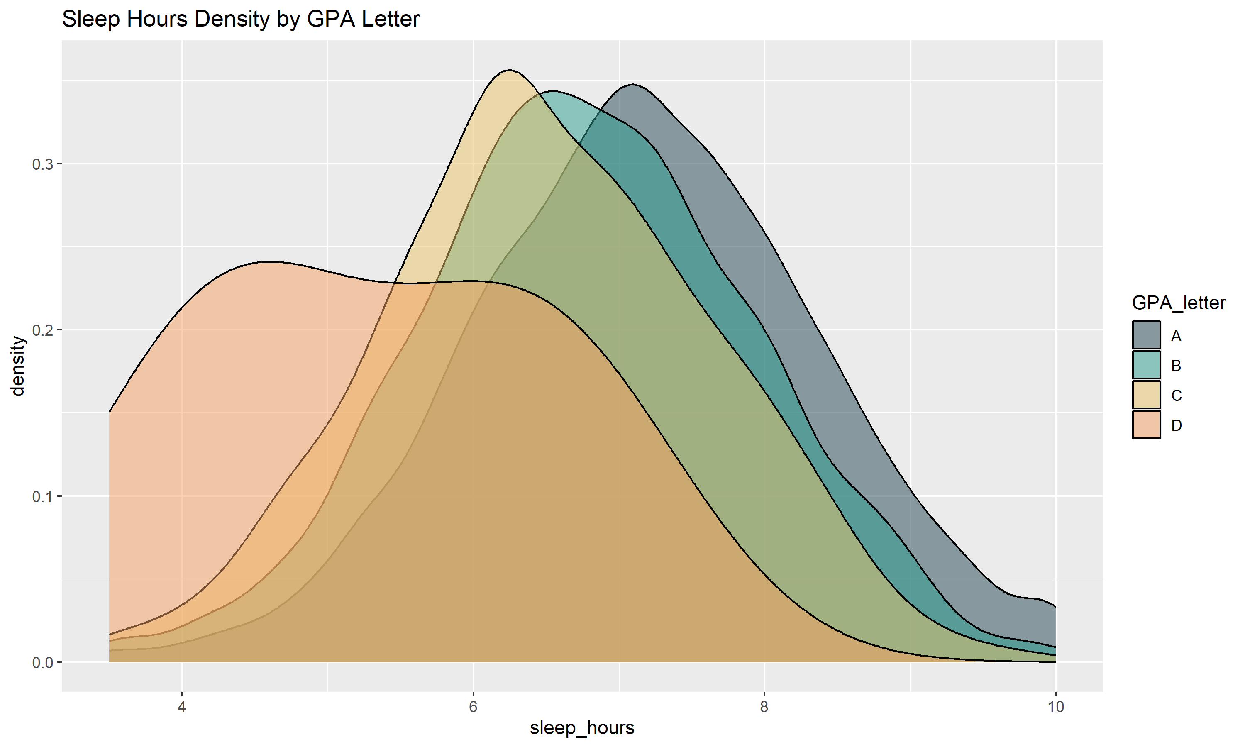
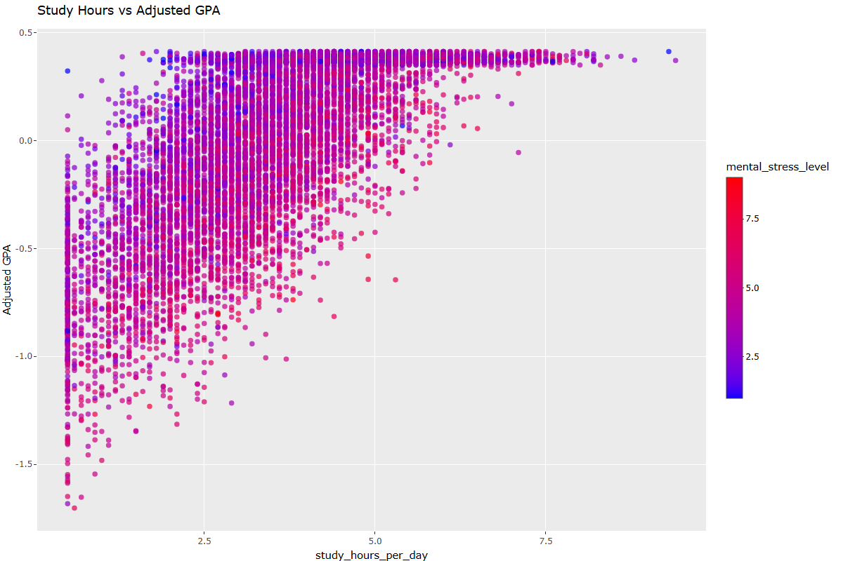
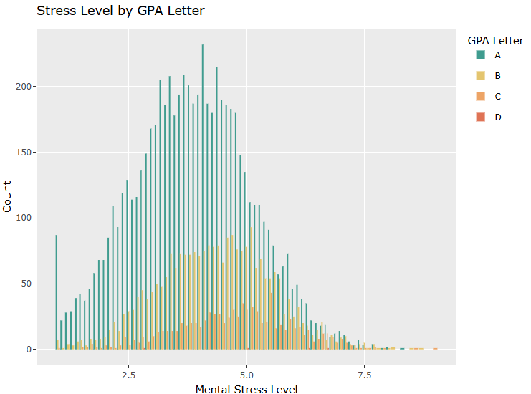
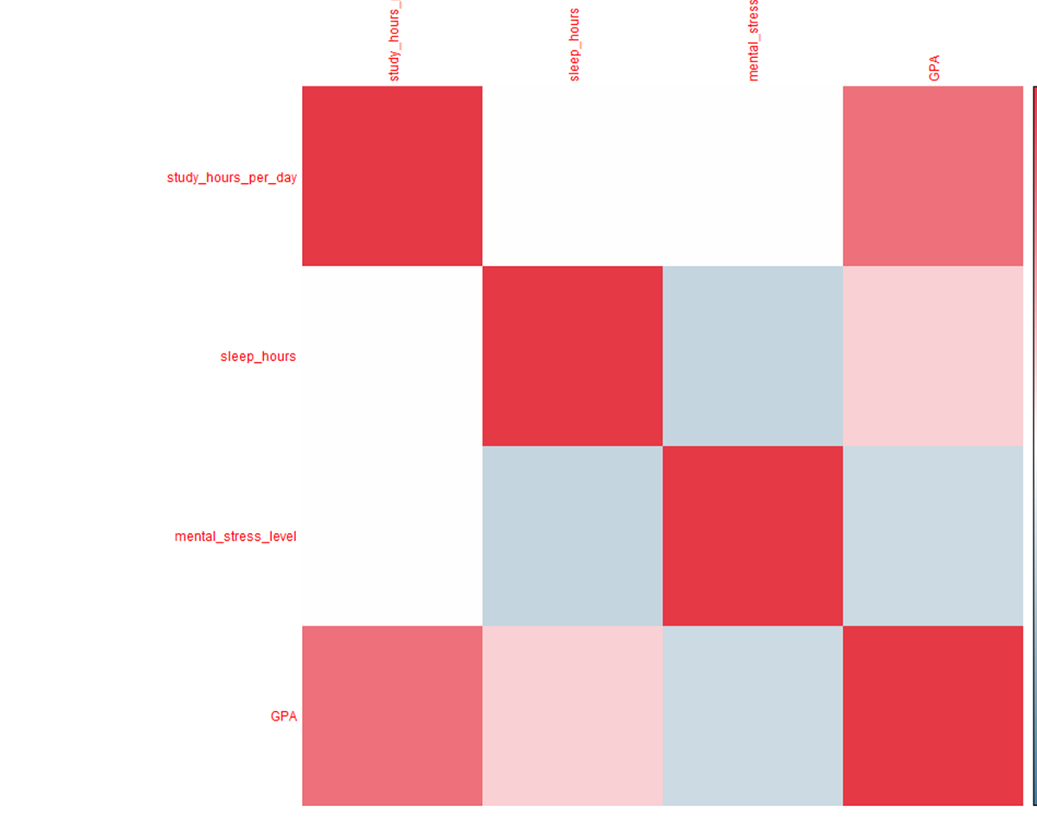
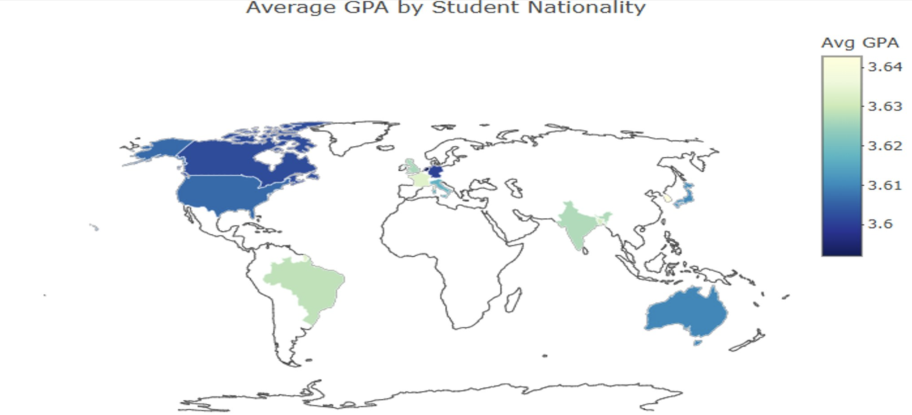
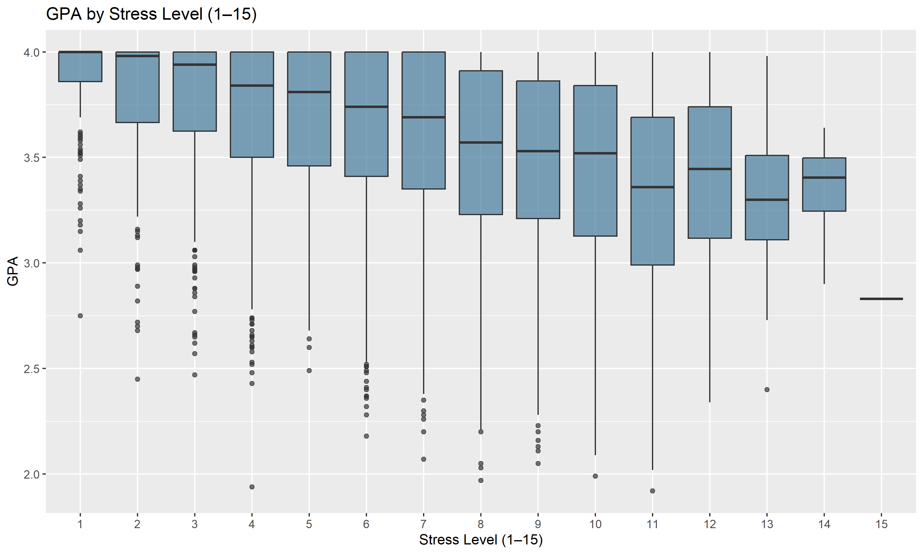
Data Visualizations

Slide 10
Data Visualization Interpretation - Stress Level by GPA Letter (Bar Graph)
This bar graph shows GPA letter distribution across stress levels.
Stress management directly influences grade outcomes. Students with lower stress achieve higher academic performance.

Slide 11
Data Visualization Interpretation - GPA by Stress Level (Box Plot)
This box plot compares GPA distributions across stress levels.
Stress not only lowers average GPA but also increases performance inconsistency.

Slide 12
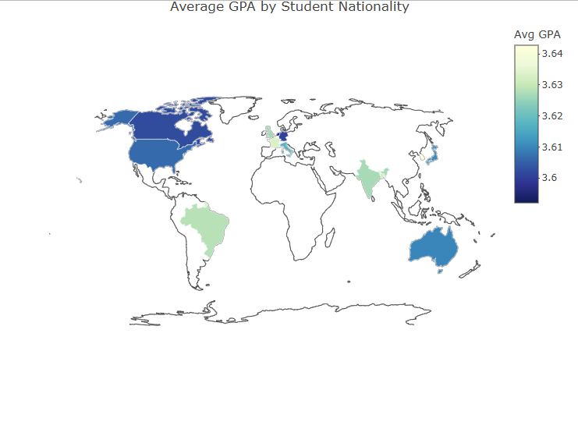
Data Visualization Interpretation - Average GPA by Student Nationality (Choropleth Map)
This choropleth map shows how the average GPA differs by country. Each nation’s color reflects its students’ overall academic performance.
Darker shades = higher GPAs.
Lighter shades = lower GPAs.
Regional clusters appear — some areas consistently outperform others.
Academic results vary globally, likely influenced by education systems, culture, and resources.

Slide 13
Data Visualization Interpretation - Correlation Heatmap
This correlation heatmap displays the strength and direction of linear relationships among four key variables in the dataset:
Sleep hours
Mental stress level
GPA
Study Hours
The heatmap shows a moderate positive correlation, meaning students who study more tend to have higher GPAs. There is a small positive correlation, suggesting that students who sleep more tend to have slightly higher GPAs. This is a negative correlation, meaning higher stress levels are associated with lower GPAs.

Slide 14
Data Visualization Interpretation - Sleep Hours Density by GPA Letter (Density Chart)
This density plot shows sleep hour distributions for each GPA letter category.
A-grade students cluster around 7–8 hours of sleep.
Consistent sleep habits are a strong predictor of academic success.

Slide 15
Data Visualization Interpretation - Study Hours vs Adjusted GPA (Scatter Plot)
This scatter plot shows the relationship between daily study hours and GPA. Color intensity represents mental stress levels.
Moderate study hours with low stress (blue points) yield the most consistent positive outcomes.
Study time improves GPA, but excessive stress undermines benefits. Balance between workload and mental health is key.

Slide 16
Conclusions
Students who study more generally earn higher GPAs, but pushing study time too far raises stress, which starts to hurt performance.
Sleep is a major positive factor; students who sleep more tend to have higher GPAs and lower stress overall.
Stress is the strongest negative influence in the dataset, connecting to lower GPA, less sleep, and heavier study loads.
Top‑performing students balance study, sleep, and stress, showing steady habits rather than extremes.

